Slide 1
Mass Storage Structure
Course Instructor: Nausheen Shoaib

Slide 2
Overview of Mass Storage Structure
Magnetic disks provide bulk of secondary storage of modern computers
Drives rotate at 60 to 250 times per second
Transfer rate is rate at which data flow between drive and computer
Positioning time (random-access time) is time to move disk arm to desired cylinder (seek time) and time for desired sector to rotate under the disk head (rotational latency)
Head crash results from disk head making contact with the disk surface -- That’s bad
Disks can be removable
Drive attached to computer via I/O bus
Busses vary, including EIDE, ATA, SATA, USB, Fibre Channel, SCSI, SAS, Firewire
Host controller in computer uses bus to talk to disk controller built into drive or storage array

Slide 3
Moving-head Disk Mechanism

Slide 4
Hard Disk Performance
Access Latency = Average access time = average seek time + average latency
For fastest disk 3ms + 2ms = 5ms
For slow disk 9ms + 5.56ms = 14.56ms
Average I/O time = average access time + (amount to transfer / transfer rate) + controller overhead
For example to transfer a 4KB block on a 7200 RPM disk with a 5ms average seek time, 1Gb/sec transfer rate with a .1ms controller overhead =
5ms + 4.17ms + 0.1ms + transfer time =
Transfer time = 4KB / 1Gb/s * 8Gb / GB * 1GB / 1024²KB = 32 / (1024²) = 0.031 ms
Average I/O time for 4KB block = 9.27ms + .031ms = 9.301ms

Slide 5
Solid-State Disks
Nonvolatile memory used like a hard drive
Can be more reliable than HDDs
More expensive per MB
Maybe have shorter life span
Less capacity
But much faster
Busses can be too slow -> connect directly to PCI for example
No moving parts, so no seek time or rotational latency

Slide 6
Magnetic Tape
Was early secondary-storage medium
Evolved from open spools to cartridges
Relatively permanent and holds large quantities of data
Access time slow
Random access ~1000 times slower than disk
Mainly used for backup, storage of infrequently-used data, transfer medium between systems
Kept in spool and wound or rewound past read-write head
200GB to 1.5TB typical storage

Slide 7
Disk Structure
Disk drives are addressed as large 1-dimensional arrays of logical blocks, where the logical block is the smallest unit of transfer
The 1-dimensional array of logical blocks is mapped into the sectors of the disk sequentially
Sector 0 is the first sector of the first track on the outermost cylinder

Slide 8
Disk Attachment
Host-attached storage accessed through I/O ports talking to I/O busses
SCSI itself is a bus, up to 16 devices on one cable, SCSI initiator requests operation and SCSI targets perform tasks
Each target can have up to 8 logical units (disks attached to device controller)
FC is high-speed serial architecture
Can be switched fabric with 24-bit address space – the basis of storage area networks (SANs) in which many hosts attach to many storage units

Slide 9
Storage Array
Can just attach disks, or arrays of disks
Storage Array has controller(s), provides features to attached host(s)
Ports to connect hosts to array
Memory, controlling software (sometimes NVRAM, etc)
A few to thousands of disks
RAID, hot spares, hot swap (discussed later)
Shared storage -> more efficiency
Features found in some file systems
Snaphots, clones, replication, etc

Slide 10
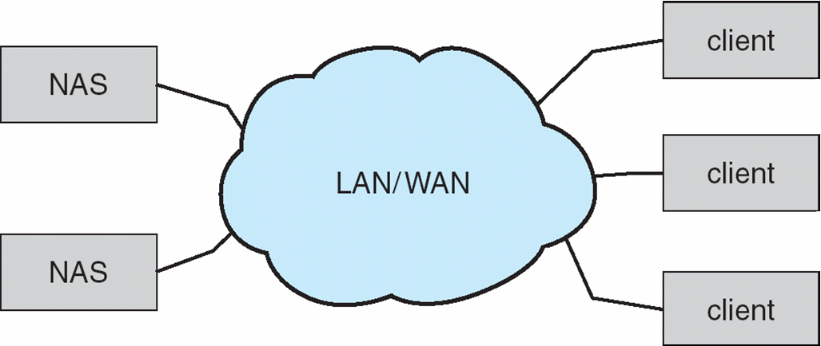
Network-Attached Storage
Network-attached storage (NAS) is storage made available over a network rather than over a local connection (such as a bus)
NFS and CIFS are common protocols
Implemented via remote procedure calls (RPCs) between host and storage over typically TCP or UDP on IP network
iSCSI protocol uses IP network to carry the SCSI protocol

Slide 11
Disk Scheduling
The operating system is responsible for using hardware efficiently — for the disk drives, this means having a fast access time and disk bandwidth
Minimize seek time
Seek time ≈ seek distance
Disk bandwidth is the total number of bytes transferred, divided by the total time between the first request for service and the completion of the last transfer

Slide 12
Disk Scheduling (Cont.)
Note that drive controllers have small buffers and can manage a queue of I/O requests (of varying “depth”)
Several algorithms exist to schedule the servicing of disk I/O requests
The analysis is true for one or many platters
We illustrate scheduling algorithms with a request queue (0-199)
98, 183, 37, 122, 14, 124, 65, 67
Head pointer 53

Slide 13
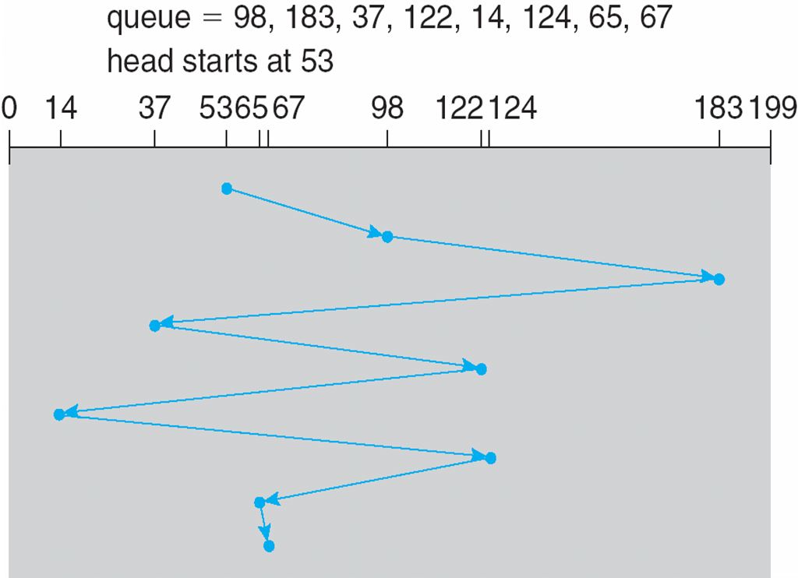
FCFS
Illustration shows total head movement of 640 cylinders

Slide 14
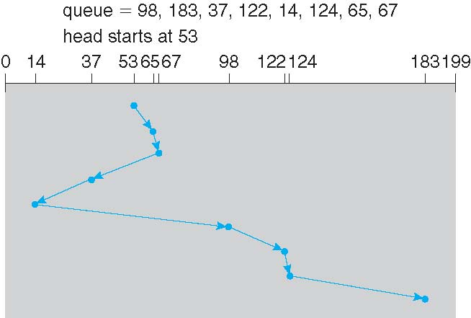
SSTF
Shortest Seek Time First selects the request with the minimum seek time from the current head position
SSTF scheduling is a form of SJF scheduling; may cause starvation of some requests

Slide 15
SCAN
The disk arm starts at one end of the disk, and moves toward the other end, servicing requests until it gets to the other end of the disk, where the head movement is reversed and servicing continues.
SCAN algorithm Sometimes called the elevator algorithm

Slide 16
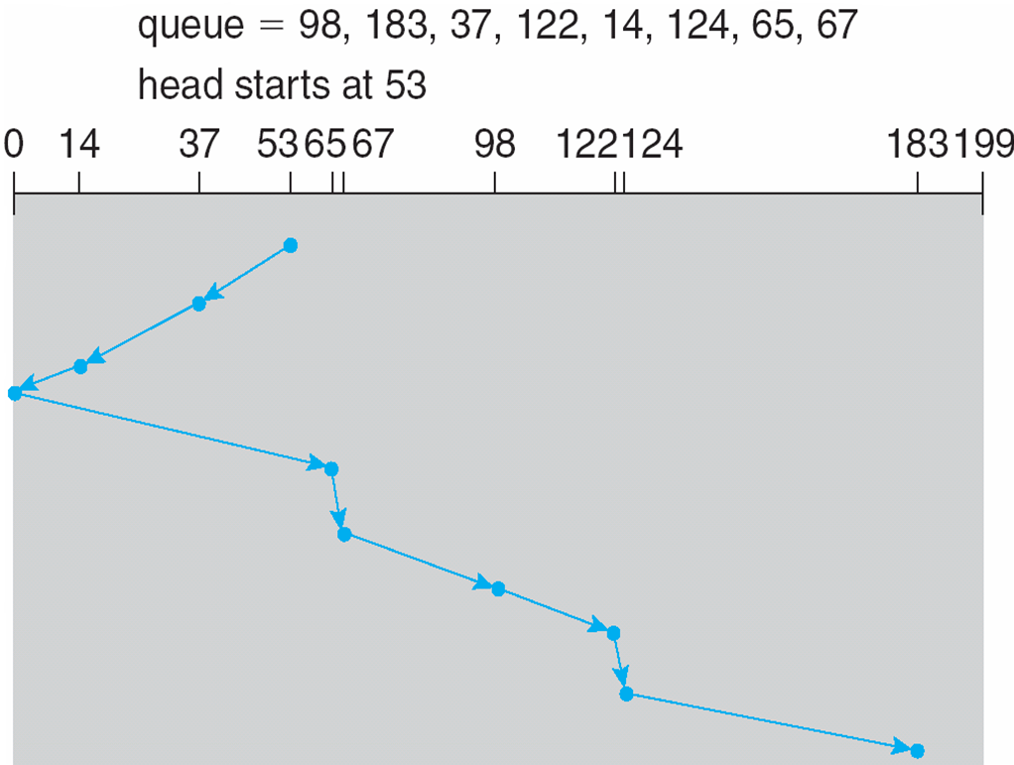
SCAN (Cont.)

Slide 17
C-SCAN
Provides a more uniform wait time than SCAN
The head moves from one end of the disk to the other, servicing requests as it goes
When it reaches the other end, however, it immediately returns to the beginning of the disk, without servicing any requests on the return trip
Treats the cylinders as a circular list that wraps around from the last cylinder to the first one

Slide 18
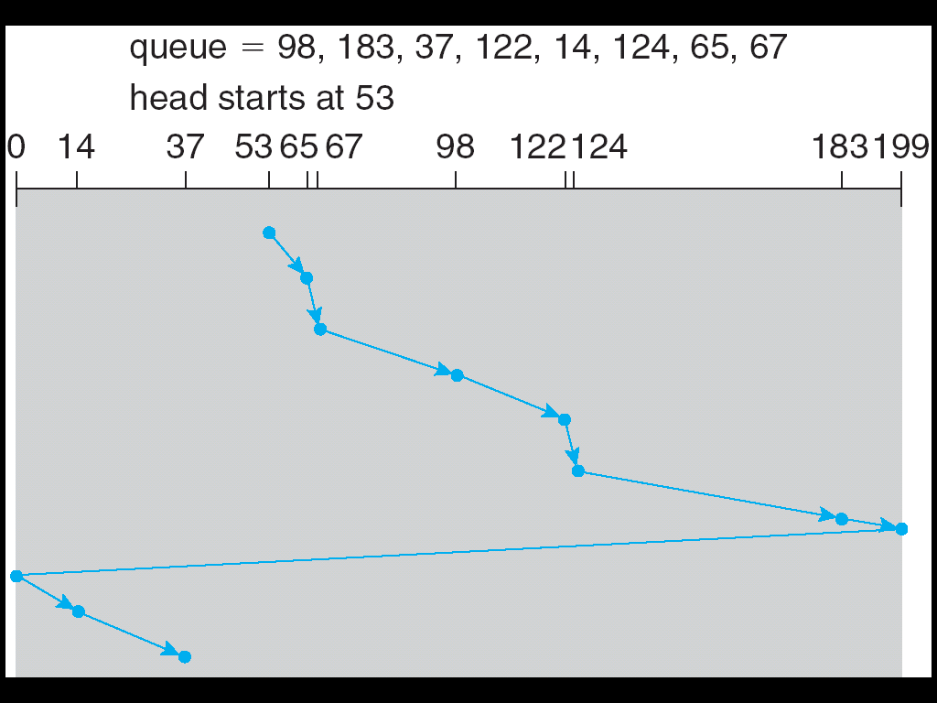
C-SCAN (Cont.)

Slide 19
C-LOOK
LOOK a version of SCAN, C-LOOK a version of C-SCAN
Arm only goes as far as the last request in each direction, then reverses direction immediately, without first going all the way to the end of the disk

Slide 20
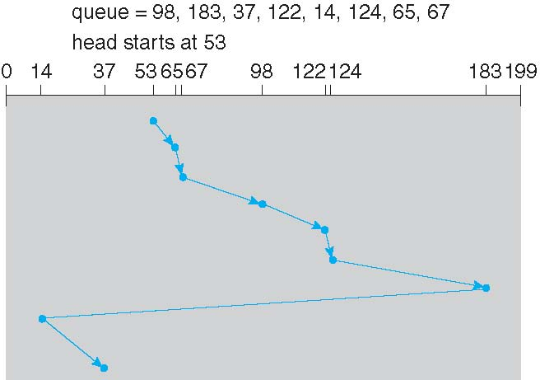
C-LOOK (Cont.)

Slide 21
Protection
Course Instructor: Nausheen Shoaib

Slide 22
Goals of Protection
A computer consists of a collection of objects, hardware or software
Each object has a unique name and can be accessed through a well-defined set of operations
Protection problem - ensure that each object is accessed correctly and only by those processes that are allowed to do so

Slide 23
Principles of Protection
A privilege is the right to execute a particular operation on a given object
Guiding principle – principle of least privilege
Programs, users and systems should be given just enough privileges to perform their tasks
Limits damage if entity has a bug, gets abused
Privileges can be one of:
Static (during life of system, during life of process)
Dynamic (changed by process as needed) – domain switching, privilege escalation
“Need to know” a similar concept regarding access to data

Slide 24
Principles of Protection (Cont.)
Must consider “grain” aspect
Rough-grained privilege management easier, simpler, but least privilege now done in large chunks
For example, traditional Unix processes either have abilities of the
associated user, or
of the root
Fine-grained management more complex, more overhead, but more protective
ACL (Access Control List)
RBAC (Role Based Access control)
Domain can be user, process, procedure

Slide 25
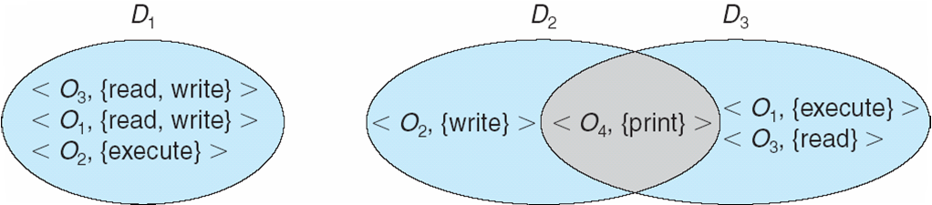
Domain Structure
Access-right = <object-name, rights-set>
rights-set is a subset of all valid operations that can be performed on the object
Domain = set of access-rights
A process, at any point in time, is associated with one domain.
Domains may overlap.

Slide 26
Domain Implementation -- UNIX
Domain = user-id
Domain switch accomplished via file system
Each file has associated with it a domain bit (setuid bit)
When file is executed and setuid = “on”, then user-id is set to the owner of the file being executed
When execution completes user-id is reset
Domain switch accomplished via passwords
su command temporarily switches to another user’s domain when other domain’s password is provided
Domain switching via commands
sudo command prefix executes specified command in another domain (if original domain has privilege or password given)

Slide 27
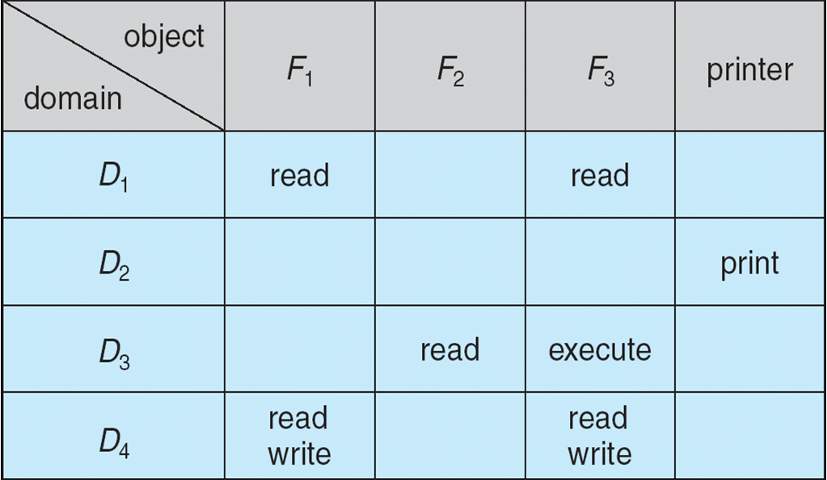
Access Matrix
View protection as a matrix (access matrix)
Rows represent domains
Columns represent objects
Access(i, j) is the set of operations that a process executing in Domain_{i} can invoke on Object_{j}

Slide 28
Use of Access Matrix
Access matrix design separates mechanism from policy
Mechanism
Operating system provides access-matrix + rules
If ensures that the matrix is only manipulated by authorized agents and that rules are strictly enforced
Policy
User dictates policy
Who can access what object and in what mode
But doesn’t solve the general confinement problem
guaranteeing that no information initially held in an object can migrate outside of its execution environment
More later

Slide 29
Domain Switching
Access matrix also provides a mechanism to control the switching from one domain to another.
Columns can be either “objects” or “domains”.
Have a special access right:
switch – to designate the privilege to transfer from one domain to another.
If an entry in the matrix contains “switch”, then a switch is allowed.

Slide 30
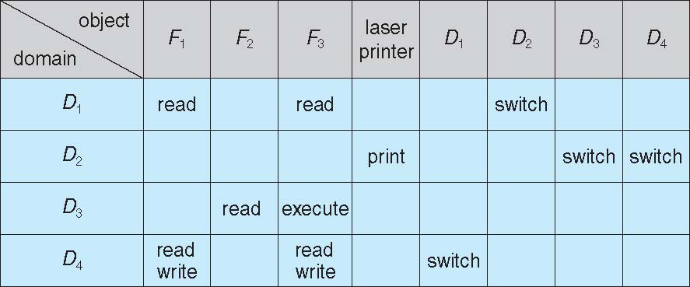
Access Matrix with Domains as Objects

Slide 31
Access Matrix -- Dynamic Protection
Operations to add and delete access rights
Special access rights:
owner of O_{i}
copy op from O_{i} to O_{j} (denoted by “*”)
control – D_{i} can modify D_{j} access rights
transfer – switch from domain D_{i} to D_{j}
Copy and Owner applicable to an object
Control applicable to domain object

Slide 32
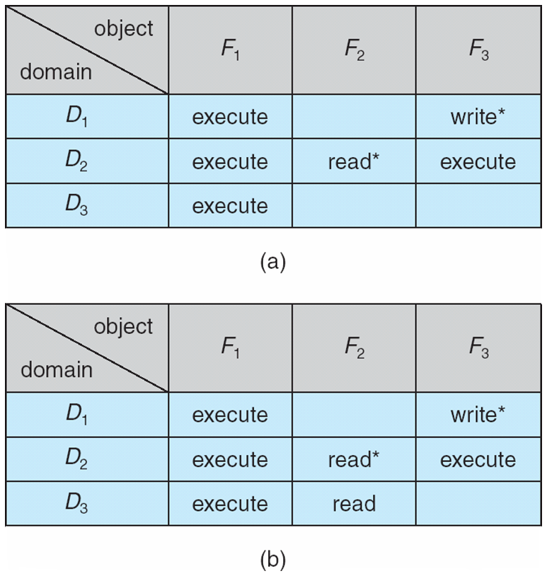
Access Matrix With Copy ( * ) Rights
A process in domain D₂ can copy the “read” access right to any entry in column F₂

Slide 33
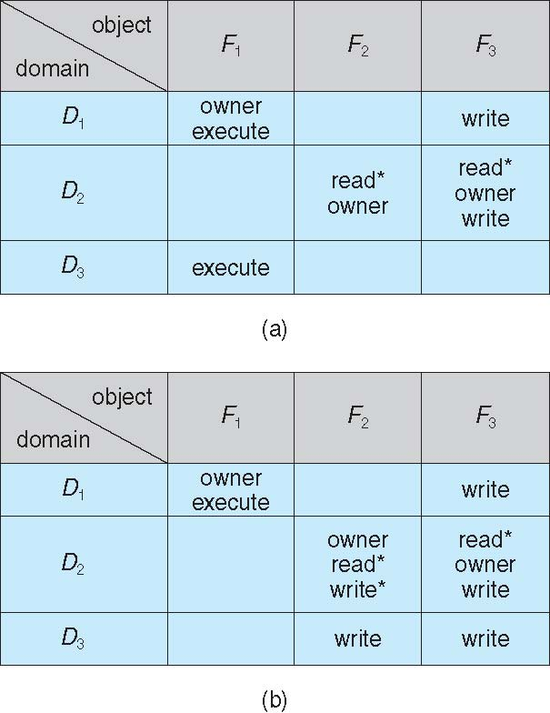
Access Matrix With owner Rights
A process executing in domain D₁ can add and remove any right in any entry in column F₁

Slide 34
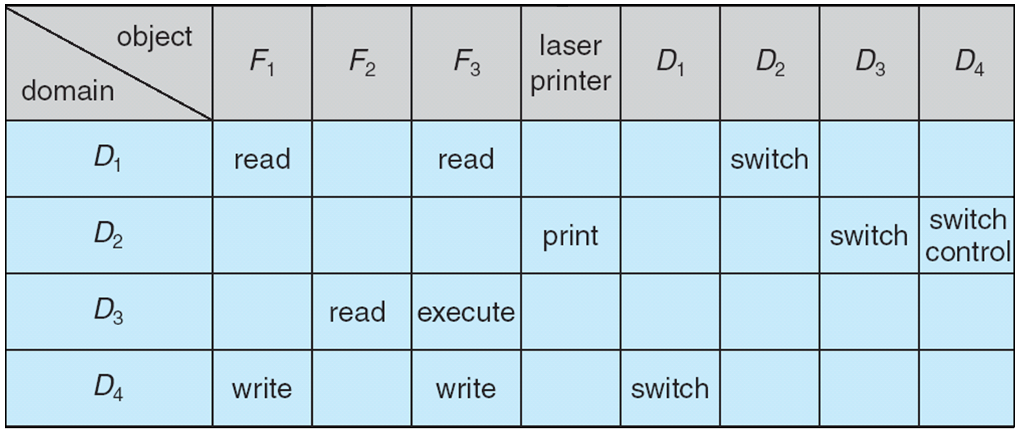
Access Matrix with control Rights
A process executing in domain D₂ can add and remove any right in any entry in row D₄.

Slide 35
Security (Reading Assignment)
Course Instructor: Nausheen Shoaib

Slide 36
Introduction to Security
Security considers the external environment with which the system operates
System must be guarded against
Unauthorized access
Malicious destruction or alteration
Accidental introduction of inconsistency
Security Problem
System is secure if its resources are used as intended under all circumstances
Security violations are categorized as intentional or accidental

Slide 37
System Security
Intruder and cracker
Those attempting to breach security
Threat: Potential for security violation
Attack: Attempt to break security
Accidental and malicious security violations
Breach of confidentiality
Unauthorized reading of data or theft of
information
Breach of Integrity
Unauthorized modification of data
Breach of availability
Unauthorized destruction of data
Theft of service
Unauthorized use of resources

Slide 38
System Security
Denial of service
Preventing legitimate use of the system
Common methods of breaching security
Masquerading
Participant in a communication pretends to be someone else
Attacker breaches authentication
Replay Attack
Malicious or fraudulent repeat of a valid data transmission
Done along with a modified message
3. Man-in-the-middle attack
Attacker sits in the data flow of a communication
Masquerading as sender to the receiver

Slide 39
System Security
Absolute protection of a system from malicious abuse is not possible
Security measures are taken at four levels
Physical
Sites with computer systems must be physically secured
2. Human
Authorization must be done carefully to allow only appropriate users to have access to the system
Phising:
Legitimate looking email or webpage misleads a user to enter confidential information

Slide 40
System Security
Dumpster diving:
Attempting to gather information to gain unauthorized access to the system
3. Operating System
System must protect itself from accidental or purposeful security breaches
4. Network
Intercepting data communicated over a network
Breaking into a computer
System must provide protection to allow the implementation of security features

